Slide 1
Using Charts in a Presentation
Microsoft Powerpoint 2013
Lesson 6

Slide 2
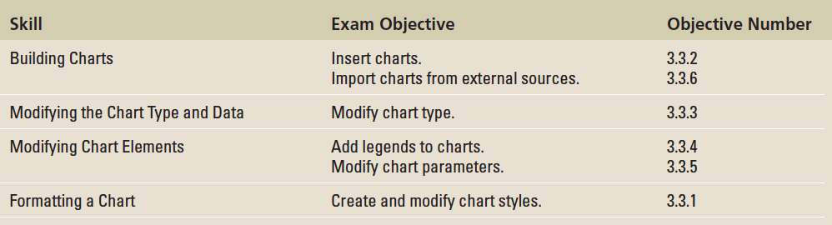
Objectives

Slide 3
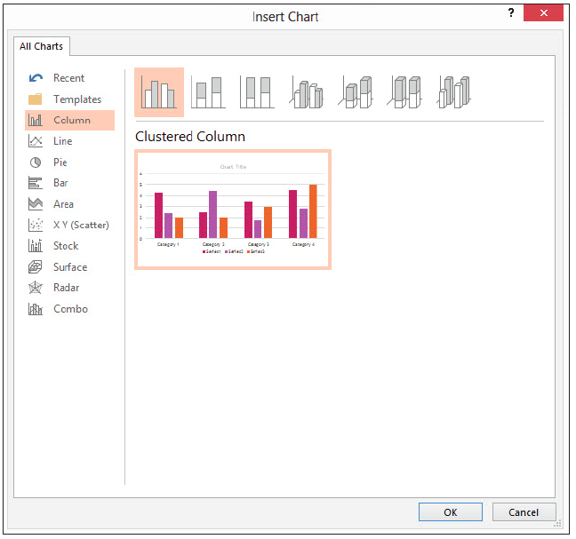
Step by Step: Insert a Chart
GET READY. Before you begin these steps, make sure that your computer is on. Log on, if necessary.
START PowerPoint if the program is not already running.
Locate and open the Revenues presentation and save it as Revenues Final.
Go to slide 3. Click the Insert Chart icon in the center of the content placeholder. The Insert Chart dialog box opens (above), showing chart types and subtypes.

Slide 4
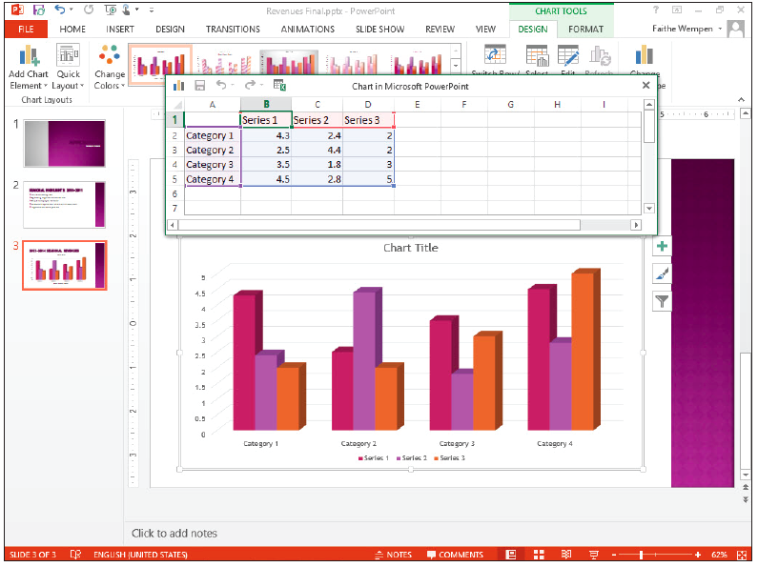
Step by Step: Insert a Chart
Click the 3D Clustered Column chart subtype (the fourth from the left in the row of icons across the top of the dialog box).
Click OK. A Chart in Microsoft PowerPoint window opens on top of the PowerPoint window containing the sample data on which the chart is based (right). It is similar to an Excel worksheet. Notice the bright-blue border that surrounds the data range. This range border is used to indicate the data being charted.

Slide 5
Step by Step: Insert a Chart
Drag the marker in the bottom right corner of the range border so that the range includes only cells A1:C5.
Select Column D, and then press Delete to clear the selected cells.
Click cell B1 and type 2013, replacing the current entry. Then press Tab to move to cell C1. Type 2014, and press Enter.

Slide 6
Step by Step: Insert a Chart
Beginning in cell A2, type the following data in Excel to complete the chart:
Spring $89,000 $102,000
Summer $54,000 $62,000
Fall $102,000 $118,000
Winter $233,000 $267,000

Slide 7
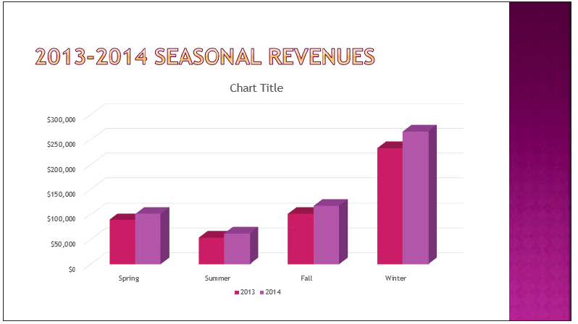
Step by Step: Insert a Chart
Close the worksheet window. The chart appears with the data you entered (right).
SAVE the presentation.
PAUSE. LEAVE the presentation open to use in the next exercise.

Slide 8
Step by Step: Import an Excel Chart
USE the Revenues Final presentation that is still open from the previous exercise.
With slide 3 selected, click New Slide on the Home tab. A new slide appears at the end of the presentation.
Open Microsoft Excel, and open the Beverages file from the data files for this lesson. Select the chart, and then press Ctrl+C to copy it to the Clipboard.
Switch back to PowerPoint and select the outer frame of the content placeholder box. Click twice on it to make sure the placeholder box itself is selected.

Slide 9
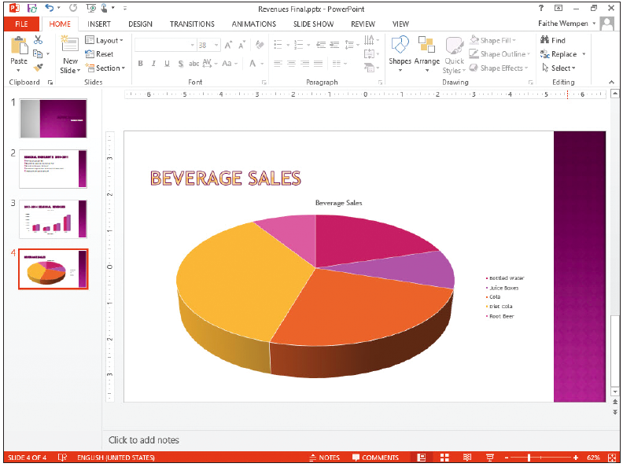
Step by Step: Import an Excel Chart
Press Ctrl+V to paste the chart into the placeholder.
Click in the slide’s title placeholder box and type Beverage Sales (right). Do not worry that the same title also appears above the chart; you will learn how to fix that later.
Switch back to Excel, and exit Excel.
In PowerPoint, SAVE the presentation.
PAUSE. LEAVE the presentation open to use in the next exercise.

Slide 10
Step by Step: Resize and Move a Chart
USE the Revenues Final presentation that is still open from the previous exercise.
Select the chart on slide 3.
Position the pointer on the lower-right corner of the chart’s frame, so the mouse pointer becomes a double-headed arrow.
Drag inward to decrease the size of the chart by about 2” in width.
Position the pointer anywhere on the chart’s frame except on one of the sizing handles. The mouse pointer becomes a four-headed arrow.
Notes:
Take Note: Optionally, you can hold down Shift while resizing to maintain the aspect ratio.

Slide 11
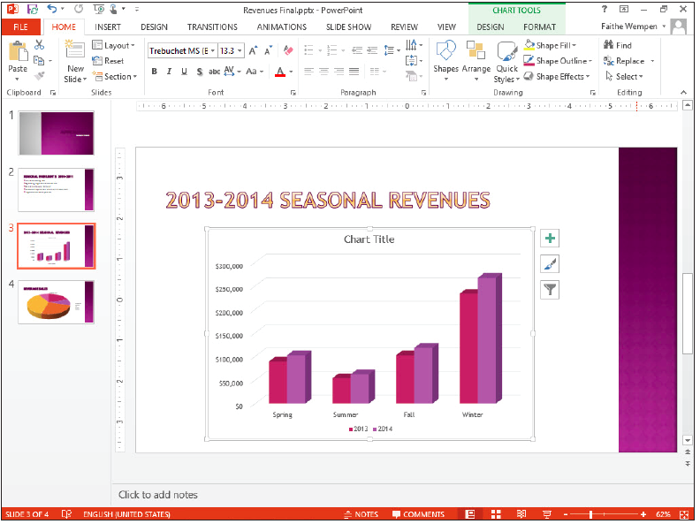
Step by Step: Resize and Move a Chart
Drag to reposition the chart so that it is centered attractively on the slide (right).
Click outside of the placeholder, and then SAVE the presentation.
PAUSE. LEAVE the presentation open to use in the next exercise.

Slide 12
Step by Step: Choose a Different Chart Type
USE the Revenues Final presentation that is still open from the previous exercise.
In PowerPoint, click the Change Chart Type button on the Chart Tools Design tab. The Change Chart Type dialog box opens showing the same chart types that appeared when you first created the chart.
On the list of chart types at the left, click Bar.

Slide 13
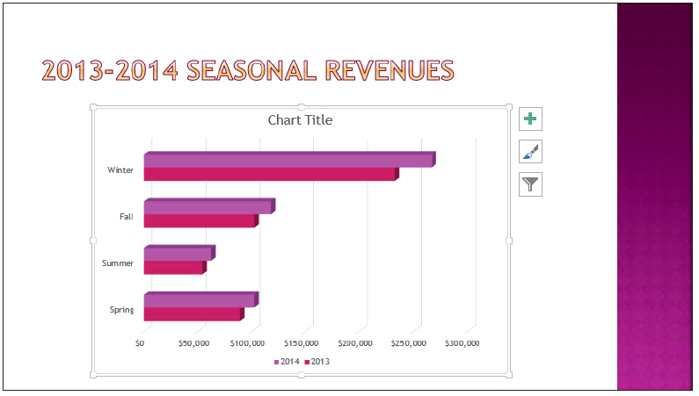
Step by Step: Choose a Different Chart Type
Click the 3-D Clustered Bar subtype, and then click OK. The columns change to horizontal bars (right).
SAVE the presentation and close it. Leave PowerPoint open for the next exercise.
PAUSE.
You can change any chart type to any other type, but the result may not always be what you expect, and you may lose some data.

Slide 14
Step by Step: Edit a Chart’s Data
GET READY. To edit a chart’s data, do the following:
OPEN the Pricing presentation and save it as Pricing Final. Examine the information on the slides, and notice that the dates on the title slide do not agree with the dates on the chart.
Go to slide 2 and click the chart to select it.
On the Chart Tools Design tab, click the Edit Data button in the Data group. The data worksheet opens.

Slide 15
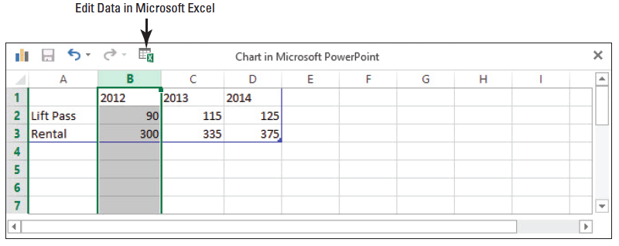
Step by Step: Edit a Chart’s Data
Click cell B1 and type 2011, replacing the current entry there. Then press Tab to move to cell C1, and type 2012, replacing the current entry. Repeat the process for D1 (2013) and E1 (2014).
Click column B’s column header to select the entire column, and then right-click the column and click Delete. The data in the worksheet should now resemble the figure below.

Slide 16
Step by Step: Edit a Chart’s Data
Click the Edit Data in Microsoft Excel icon on the worksheet window’s toolbar. The data opens in Excel.
Click cell A3 and type Equipment Rental, replacing the current entry there.
Close the Excel window and return to PowerPoint. Select the chart again if it is not still selected.
If the Switch Row/Column button is available on the Chart Tools Design tab, click it to switch rows and columns. If it is not, do the following to switch rows and columns:
a. Click Select Data. The Select Data Source dialog box opens.
b. Click Switch Row/Column (see next slide).
c. Click OK.

Slide 17
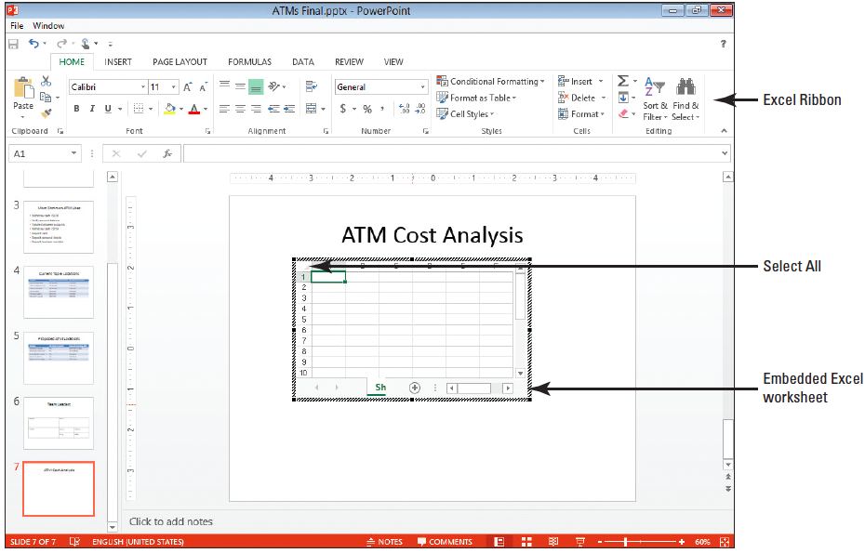
Step by Step: Edit a Chart’s Data

Slide 18
Step by Step: Edit a Chart’s Data
Click the Switch Row/Column button on the Chart Tools Design tab to switch the rows and columns back to their original settings. (Even if the button was unavailable in step 9, it will be available now.)
Close the worksheet window if it is still open.
SAVE the presentation.
PAUSE. LEAVE the presentation open to use in the next exercise.

Slide 19
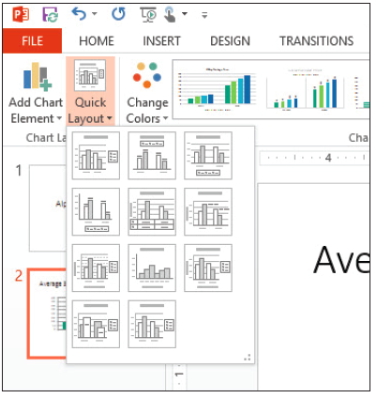
Step by Step: Apply and Modify a Quick Layout
USE the Pricing Final presentation that is still open from the previous exercise.
With the chart on slide 2 selected, click the Quick Layout button on the Chart Tools Design tab. The Chart Layout gallery displays (right).
Notes:
Take Note: The thumbnails in the Chart Layout gallery show in miniature the new layout and elements of the chart.

Slide 20
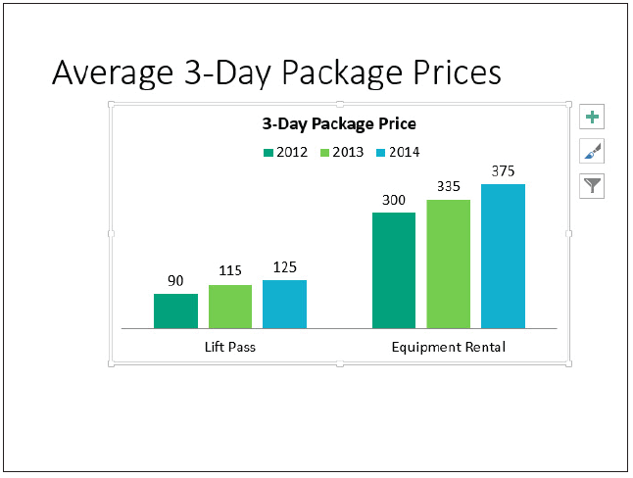
Step by Step: Apply and Modify a Quick Layout
Click Layout 2 in the gallery. The layout is modified to place the legend above the chart and add data labels to each of the bars (right).

Slide 21
Step by Step: Apply and Modify a Quick Layout
Click the Add Chart Element button to open a menu, point to Chart Title, and click None. The chart title is removed. (It is not necessary beca use the slide itself provides a title.)
SAVE the presentation.
PAUSE. LEAVE the presentation open to use in the next exercise.

Slide 22

Step by Step: Work with a Legend
USE the Pricing Final presentation that is still open from the previous exercise.
With the chart on slide 2 selected, click the Chart Elements button to the right of the chart. The Chart Elements list appears.
Click the Legend check box. The legend disappears.
Click the Legend check box again. The legend reappears.
An arrow appears to its right. Then click the arrow to display a submenu.

Slide 23
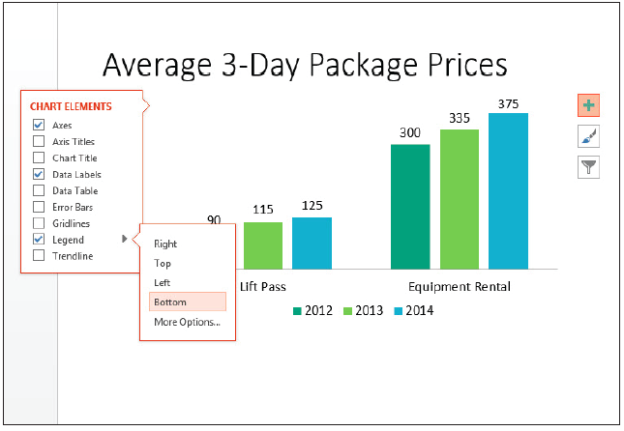
Step by Step: Work with a Legend
Click Bottom. The legend moves below the chart (below).
Click the arrow next to Legend to redisplay the submenu, and click More Options…. The Format Legend task pane opens.
Under Legend Position, click Left. The legend moves to the left of the chart area.

Slide 24
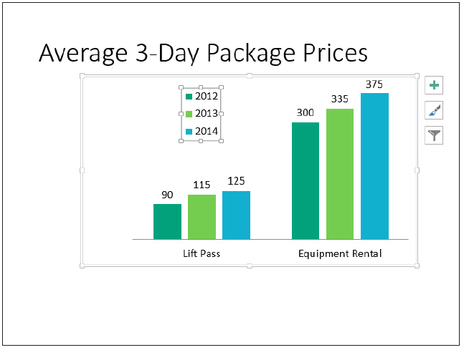
Step by Step: Work with a Legend
Close the task pane.
Position the mouse pointer over the border of the legend and drag it to place it in the empty space above the Lift Pass bars (right).

Slide 25
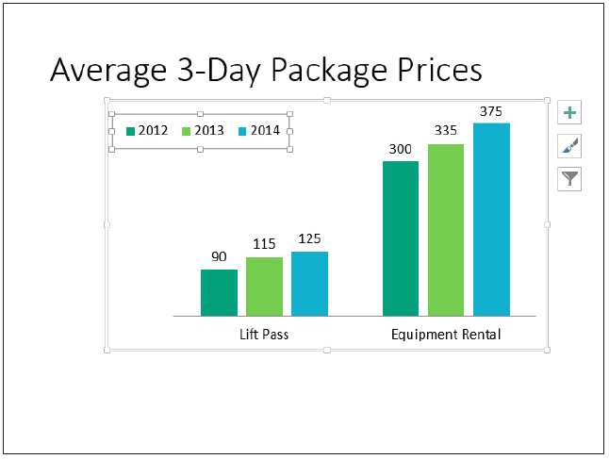
Step by Step: Work with a Legend
Drag the left side selection handle on the legend’s frame to widen the legend so that all its content fits on a single line, and drag the bottom selection handle to decrease the legend height (right).

Slide 26
Step by Step: Work with a Legend
On the Chart Tools Design tab, click Add Chart Element, point to Legend, and click Bottom to move the legend below the chart.
SAVE the presentation.
PAUSE. LEAVE the presentation open to use in the next exercise.

Slide 27
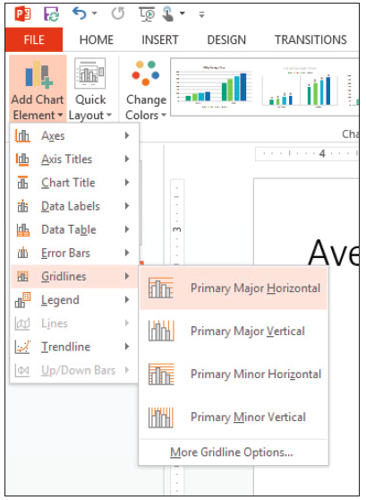
Step by Step: Add and Delete Chart Elements
USE the Pricing Final presentation that is still open from the previous exercise.
Click the chart on slide 2 to select it, and click the Chart Tools Design tab.
Click the Add Chart Element button, point to Gridlines, and click Primary Major Horizontal (right). Horizontal gridlines are added to the chart.

Slide 28
Step by Step: Add and Delete Chart Elements
Click the Add Chart Element button, point to Data Labels, and click None. The data labels disappear from the chart.
Click the chart’s outer frame to re-select the entire chart if it is not already selected.
Click the Add Chart Element button, point to Axes, and click Primary Vertical. Numbers appear along the vertical axis.
Click the Add Chart Element button, point to Data Table, and click More Data Table Options… The Format Data Table task pane opens.

Slide 29
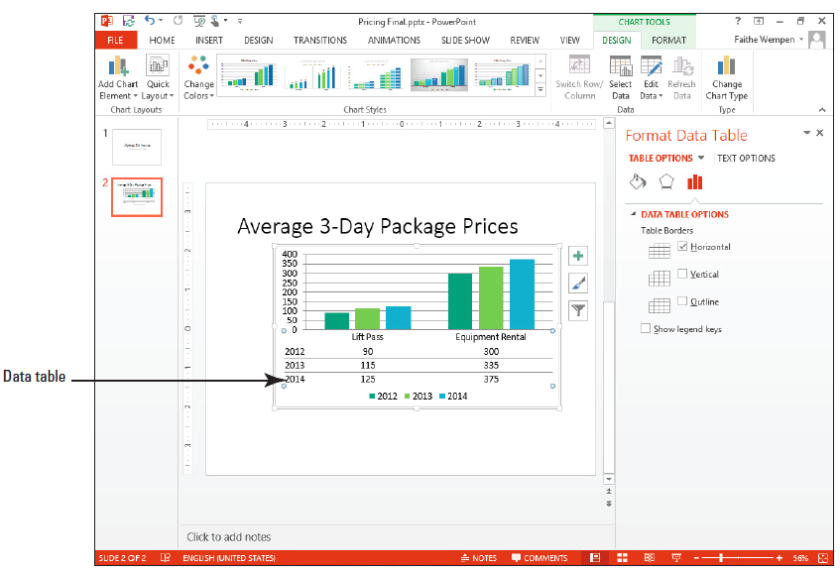
Step by Step: Add and Delete Chart Elements
Clear the Show legend keys check box.
Clear the Vertical and Outline check boxes (right).
Close the task pane.

Slide 30
Step by Step: Add and Delete Chart Elements
Drag the bottom selection handle on the chart frame downward to increase the chart’s height by approximately 1”, so that it is less crowded-looking.
SAVE the presentation and close it.
PAUSE. LEAVE PowerPoint open to use in the next exercise.

Slide 31
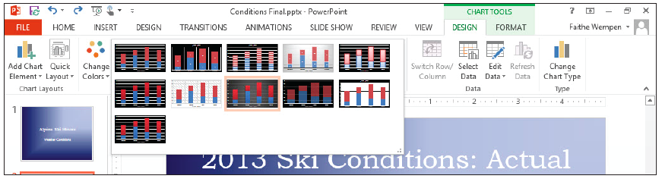
Step by Step: Apply and Modify a Chart Style
GET READY. To apply a quick style to a chart, perform the following steps:
OPEN the Conditions presentation and save it as Conditions Final.
Go to slide 2 and click the chart to select it.
On the Chart Tools Design tab, click the More button in the Chart Styles group. The Chart Styles gallery appears (below).

Slide 32
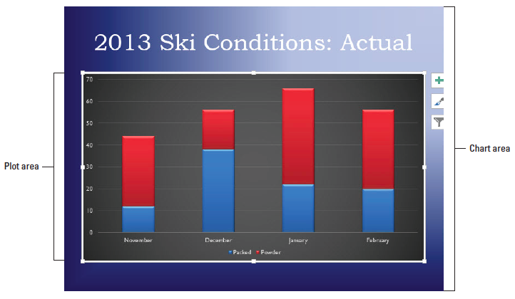
Step by Step: Apply and Modify a Chart Style
Click Style 8. This style applies new theme color, bevel effects, and a different chart background color (below).
SAVE the presentation and then CLOSE the file.
PAUSE. LEAVE PowerPoint open to use in the next exercise.

Slide 33
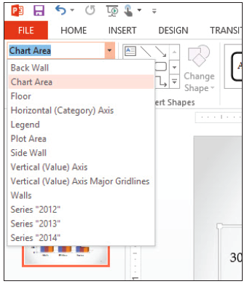
Step by Step: Change the Chart Area Fill
GET READY. To apply a chart area fill, follow these steps:
OPEN the Admissions presentation and save it as Admissions Final.
Select the chart on slide 2, and then click the Chart Tools Format tab.
If Chart Area does not already appear in the Chart Elements box, open the drop-down list in the Current Selection group and select it (right).

Slide 34
Step by Step: Change the Chart Area Fill
Click the Format Selection button below the Chart Elements box. The Format Chart Area task pane opens.
If the Fill options are collapsed in the task pane, click the Fill heading to expand it.
Click Picture or texture fill, and then click the Texture button. The texture gallery opens.

Slide 35
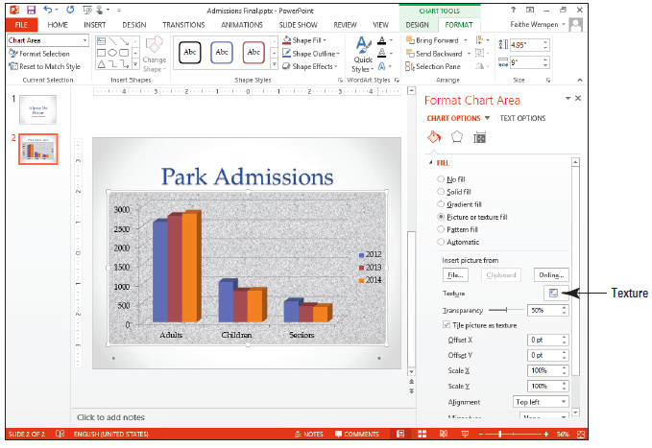
Step by Step: Change the Chart Area Fill
Click the Granite texture, and then drag the Transparency slider to 50%. The chart area has been formatted with a light texture back- ground that makes it stand out from the slide (right).
Close the Format Chart Area task pane.
SAVE the presentation.
PAUSE. LEAVE the presentation open to use in the next exercise.

Slide 36
Step by Step: Apply a Border to the Chart Area
USE the Admissions Final presentation that is still open from the previous exercise.
Click the outer border of the chart to select the chart area.
On the Chart Tools Format tab, click Format Selection in the Current Selection group to open the Format Chart Area task pane.
Click the Fill heading to collapse the Fill options. Then click the Border heading to expand the border options.
Click the Solid line option button.
Click the Color button, then click the Black, Text 1, Lighter 35% theme color.

Slide 37

Step by Step: Apply a Border to the Chart Area
Click the Width up increment arrow until the width is 3-point.
Close the task pane.
Click outside the chart so you can see the chart area border. Your slide should look similar to the figue at right.
SAVE the presentation.
PAUSE. LEAVE the presentation open to use in the next exercise.

Slide 38
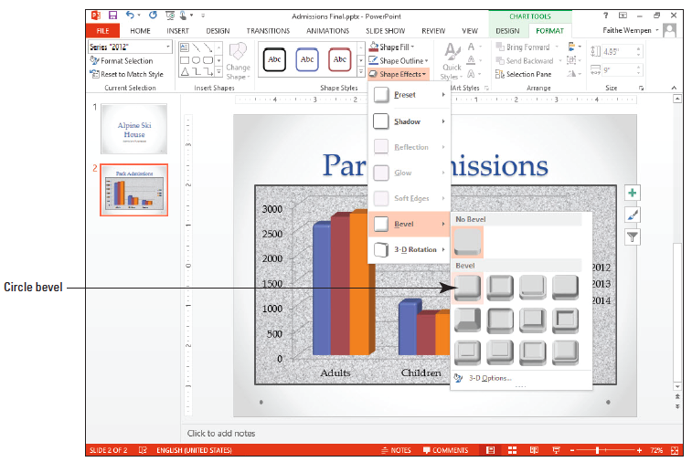
Step by Step: Apply Formatting Effects
USE the Admissions Final presentation that is still open from the previous exercise.
In the chart on slide 2, click one of the blue bars to select it. All three blue bars become selected.
On the Chart Tools Format tab, click the Shape Effects button on the Shape Styles group, and on the menu that appears, point to Bevel, and then click the Circle bevel (above).

Slide 39

Step by Step: Apply Formatting Effects
Repeat steps 1 and 2 for the red, and then the orange bars, so that all bars are formatted using the same bevel effect.
Select Chart Area from the drop-down list in the Current Selection group.
Click the Shape Effects button again, point to 3-D Rotation, and click the Perspective Heroic Extreme Right effect (the last one in the Perspective section). The entire chart receives a 3-D effect (above).
SAVE the presentation.
PAUSE. LEAVE the presentation open for the next exercise.

Slide 40
Step by Step: Format a Chart’s Data Series
USE the Admissions Final presentation that is still open from the previous exercise.
Click the chart to select it if it is not already selected.
Click one of the red bars to select the entire data series (all the red bars).
Click the Chart Tools Format tab, and notice that the Chart Elements box in the Current Selection group shows that Series “2013” is selected.
Click the Format Selection button in the Current Selection group. The Format Data Series task pane opens.
Under the Column Shape heading, click Cylinder. The bars turn to cylinders for the 2013 series.
Notes:
Take Note: If you want to format a single data bar, click on it twice.

Slide 41
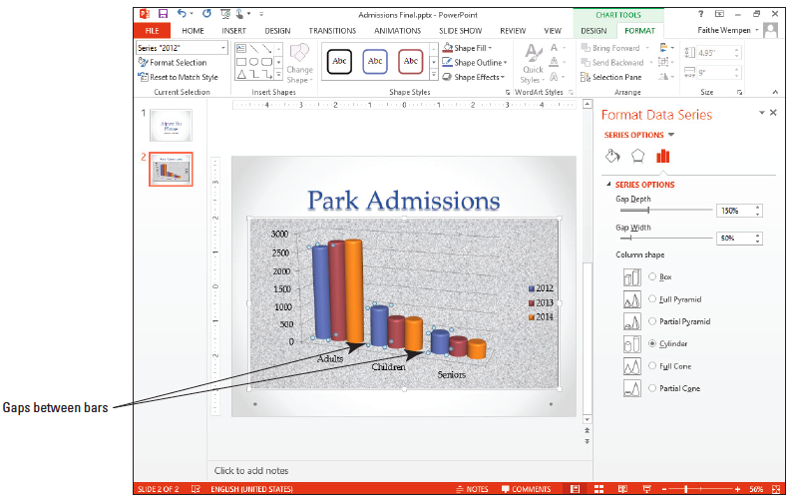
Step by Step: Format a Chart’s Data Series
Repeat step 5 for each of the other two data series.
Drag the Gap Width slider to the 50% setting. This action decreases the amount of space between the categories on the horizontal axis (below).

Slide 42
Step by Step: Format a Chart’s Data Series
Close the task pane.
SAVE the presentation.
PAUSE. LEAVE the file open for the next exercise.

Slide 43
Step by Step: Adjust a Chart Axis
USE the Admissions Final presentation that is still open from the previous exercise.
Click the chart on slide 2 to select it, if necessary.
Double-click one of the numbers on the vertical axis. The Format Axis task pane opens.
If the Axis Options icon is not selected at the top of the task pane (rightmost icon), click it. Then, if the Axis Options section is collapsed, click the heading to expand that category.

Slide 44
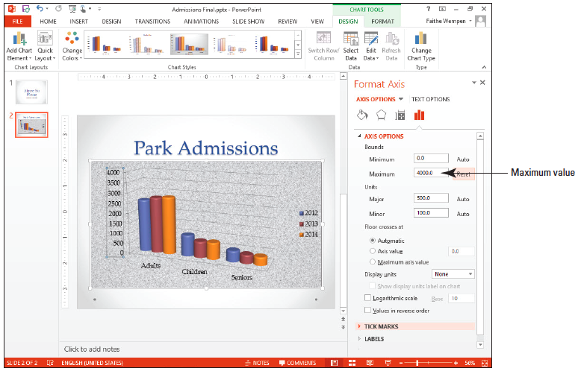
Step by Step: Adjust a Chart Axis
Under Bounds, in the Maximum text box, change the value to 4000 to establish that as the maximum value for the chart’s vertical axis (right).
Click the Reset button next to Maximum to reset the axis scale.
Click the Axis Options heading to collapse that category. Then click the Number heading to expand that category.

Slide 45
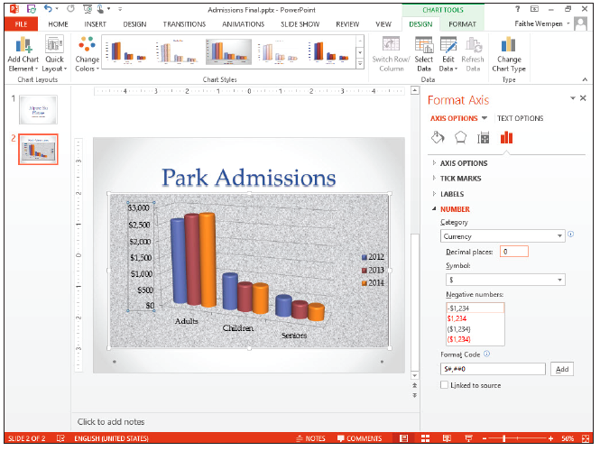
Step by Step: Adjust a Chart Axis
Open the Category drop-down list and choose Currency.
Select the value in the Decimal places box and type 0 to reduce decimal places to zero (right).
Close the task pane.
On the Home tab, open the Font Size drop-down list and click 16.

Slide 46

Step by Step: Adjust a Chart Axis
Click the Font Color button‘s drop-down arrow to open its palette, and click the dark blue square in the Standard Colors section. The chart should resemble the figure at right.
SAVE the presentation and close it.
PAUSE. Exit PowerPoint, or leave PowerPoint open to complete the end-of-lesson exercises that follow.

Slide 47
Skill Summary

